Slide 1
SUICIDE
Student Suicides
PRESENTED BY -
Nihar, Tahseen & Bhavya.

Slide 2

CONTENT
General Idea of Suicide What is Suicide
Suicide according to Durkheim Definition.
Types of Suicide Four types according to Durkheim
Student Suicide Statistical Data and Trends
Case Study Relating an example to Durkheim’s Theory
Conclusion.

Slide 3
What do you understand by Suicide??

Slide 4
Durkheim’s Theory
Suicide -
All cases of death resulting directly or indirectly from a positive or negative act of the victim himself, which he knows will produce this result.

Slide 5
Suicide - a sociological phenomena
Rate of suicide is fairly constant in different societies.

Slide 6
Types of Suicide
Egoistic
Lack of Integration to Society
Altruistic
Very high Integration to Society
Anomic
Collapse of Regulation
Sudden and unexpected changes in situations
Fatalistic
Very high Regulation
Ex Slavery

Slide 7
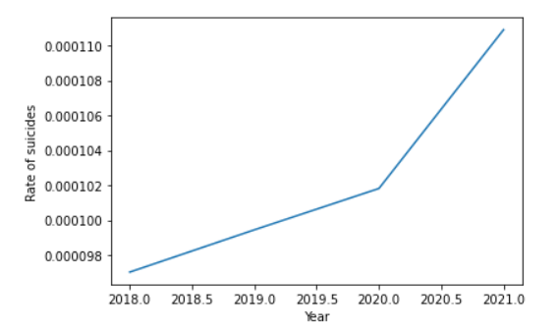
Statistical Data
WORLD LEVEL -
Nearly 800000 people die by suicide in the world each year, which is roughly ONE DEATH every 40 Sec.
Suicide is the 2nd leading cause of death in the world for those aged 15-24 years.
INDIA LEVEL -
164,033 Indians committed suicide in 2021 and the national suicide rate was 12 (calculated per hundred thousand or per lakh),
According to the Graph the number of suicides increased in 2020
In times of Covid because of forces of
Egoistic & Anomic

Slide 8
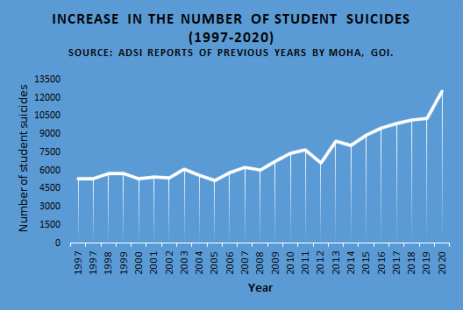
SUICIDE DATA OF STUDENTS IN INDIA
According to Durkheim’s theory we view can view a student suicide a mixture of two types
Egoistic
Fatalistic
2017 - 9900 2018 - 10200
2019 - 10300 2020 - 12500
2021 - 13100

Slide 9
Case study:
A Third-year student of mechanical engineering at Indian Institute of Technology ( IIT) Delhi, Hari Prasath, died in his hostel on campus on June 1 2021.
The email from dean students’ welfare, IIT Delhi, sent on June 4 said: "He was an introvert [student], His parents, friends and counsellors have confirmed that he was being treated for depression. A suicide note, handed over to the SHO confirms that this was death by suicide."
He was undergoing treatment for depression on the campus. Until the end of the second year, Prasath was doing well at IIT Delhi. After that he began to struggle with studies, the letter said. Prasath had left all his class groups on messaging applications. He had also withdrawn from social media.

Slide 10

A section of students from the institute had issued a statement:
They statement says language barrier and cultural isolation is one of the major issues on campus.
“The campus failed to become a place where our friend could feel a sense of belonging and was left with a very small circle of close friends with whom he could communicate,”
Demanded a "fully empowered institute-level commission"
The students’ statement said that Prasath consistently received ‘F’ grades over the past and current semester. The students now demand the IITs do not award ‘F’ grade to any student during a pandemic.
EGOISTIC TYPE
Stemming from the absence of social integration, Individualism overpowers the sense of belonging and person feels alienated.
For more info: https://www.bspiitd.com/post/the-lens-of-despair https://library.iitd.ac.in/sites/default/files/2021-10/June%201-30%2C%202021.pdf

Slide 11

CONCLUSION.
-Suicide is more of a social phenomenon than it is a psychological.
-Pushing a person to their social extreme may provoke them to take drastic steps.
-We can detect and help people suffering from suicidal thoughts by observing and regulating their social environment.

